Slide 1



Development of master curricula for natural disasters risk management in Western Balkan countries
Academy of Criminalistic and Police Studies
Dane Subošić
Academy of Criminalistic and Police Studies
Development of master curricula for natural disasters risk management in Western Balkan countries/ 15.12.2016.
Project number: 573806-EPP-1-2016-1-RS-EPPKA2-CBHE-JP
"This project has been funded with support from the European Commission. This publication reflects the views only of the author, and the Commission cannot be held responsible for any use which may be made of the information contained therein"

Slide 2

Development of master curricula for natural disasters risk management in Western Balkan countries

Slide 3
Development of master curricula for natural disasters risk management in Western Balkan countries
8 February1921
The first State Police School was established by the Decree of the Ministry of Interior.
This date is the starting point for higher police education in Serbia.

Slide 4
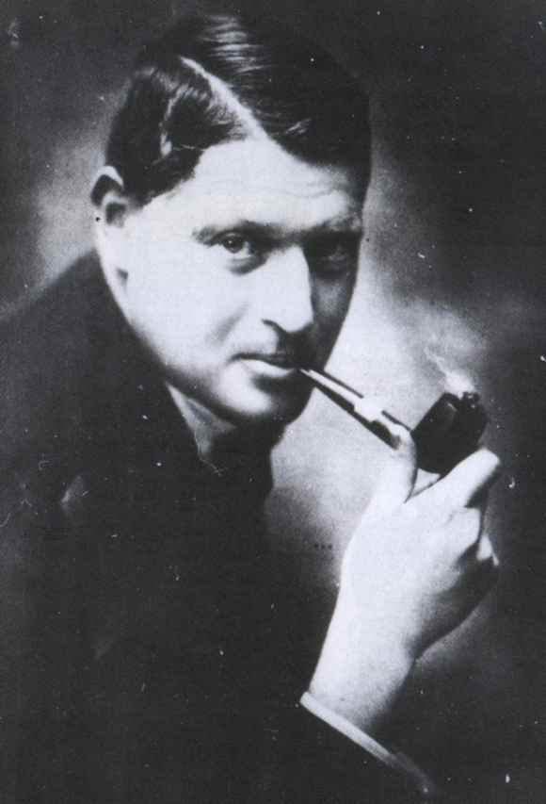
Development of master curricula for natural disasters risk management in Western Balkan countries
The initiator of the establishment of the first police higher education institution in Serbia, and its first director, was Rodolphe Archibald Reiss (1875-1929)

Slide 5
After the establishment of the first police school in 1921, the following educational institutions contributed to the development of police education in Serbia:
Development of master curricula for natural disasters risk management in Western Balkan countries
Central School for executive police officers, founded on 21 January 1931 in Zemun.
Until 1966, the following institutions were responsible for professional police education and training: School for Non-Commissioned and Commissioned Police Officers in Zemun, College of State Security Administration, College of Militia in Sremska Kamenica and Internal Administration College.
The Police High School was founded in 1967 in Sremska Kamenica.
The Police College was founded on 13 July 1972.
The Police Academy was founded on 30 June 1993.

Slide 6
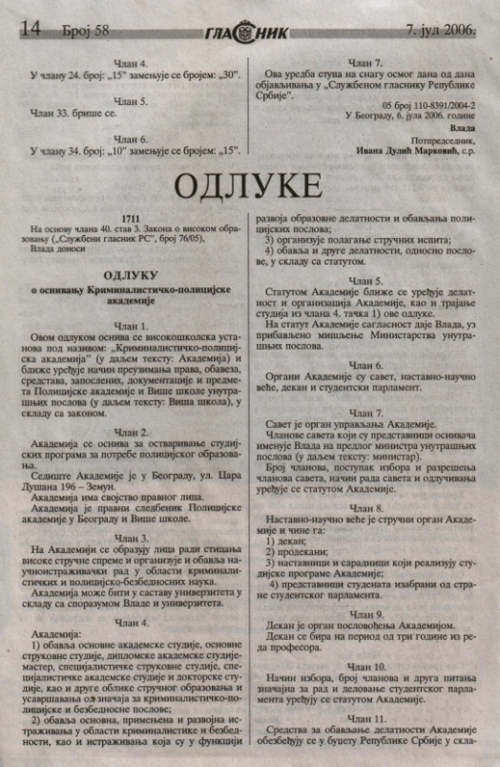
Development of master curricula for natural disasters risk management in Western Balkan countries
In accordance with the contemporary requirements and needs of the profession, the Police Academy and the Police College were integrated into the Academy of Criminalistic and Police Studies on 7 July 2006, as an independent higher education institution, by the Decision of the Government of the Republic of Serbia.

Slide 7
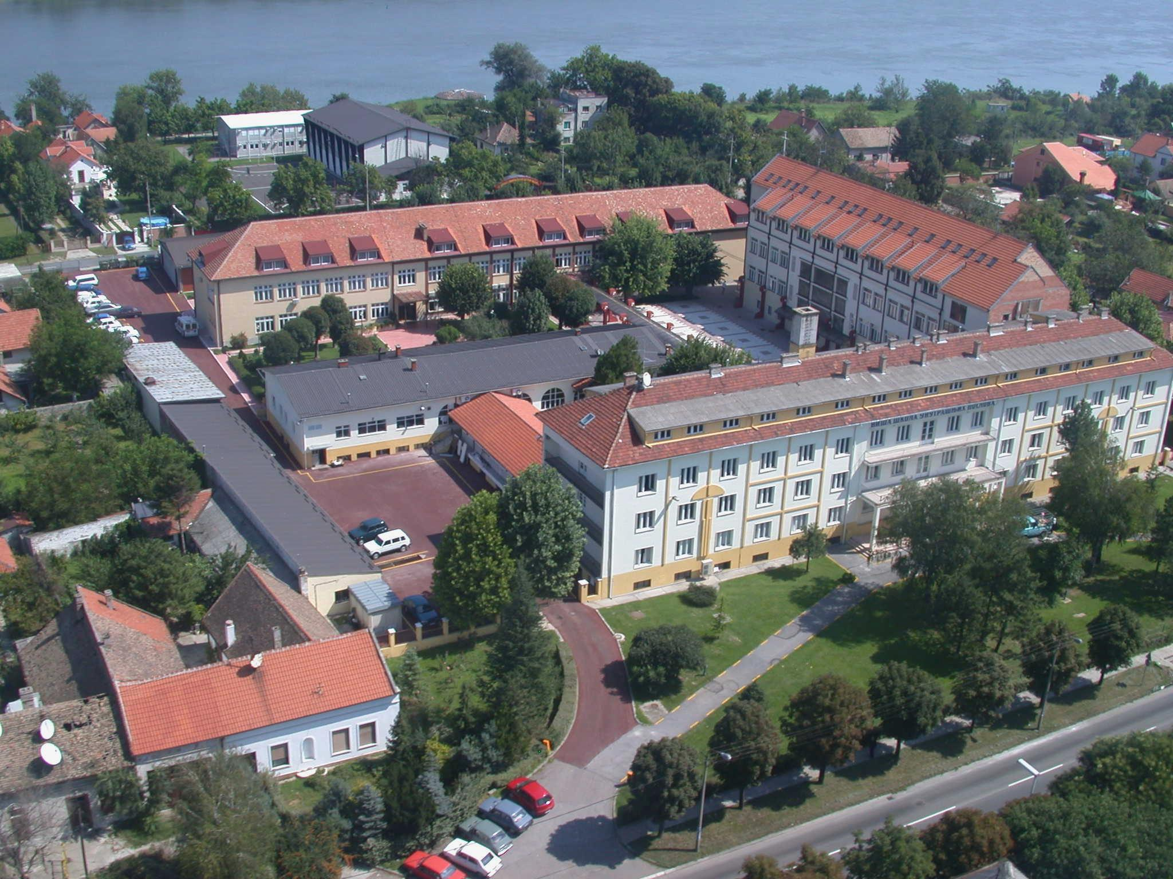
Development of master curricula for natural disasters risk management in Western Balkan countries

Slide 8
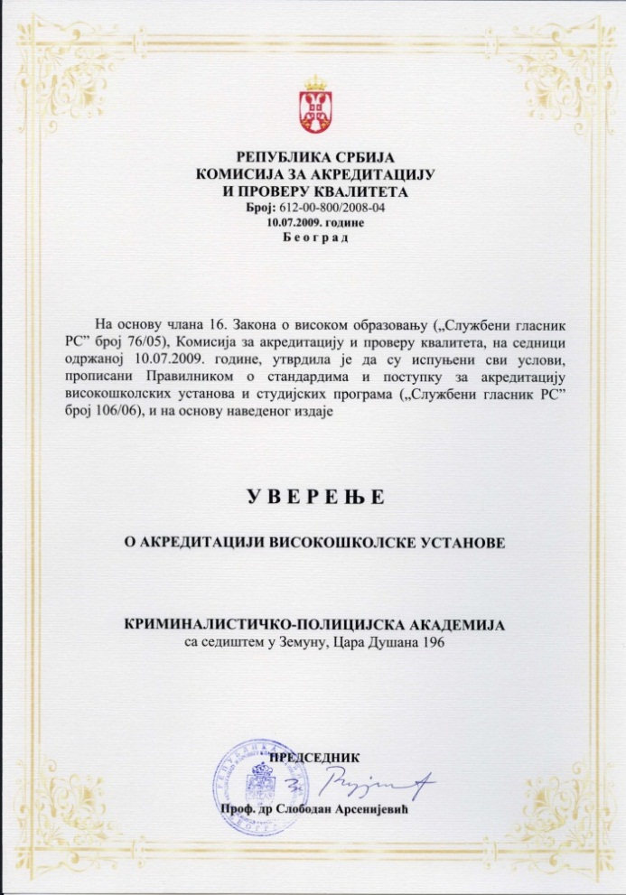
Development of master curricula for natural disasters risk management in Western Balkan countries
The Academy of Criminalistic and Police Studies is accredited by the Ministry of Education of the Republic of Serbia – which is an official confirmation that it has met all the requirements in accordance with legal regulations and university standards for the implementation of accredited study programs.

Slide 9

Development of master curricula for natural disasters risk management in Western Balkan countries
CURRICULA

Slide 10
BACHELOR’S DEGREE STUDIES
Development of master curricula for natural disasters risk management in Western Balkan countries
Criminalistics
IT and Computer Science
Forensic Engineering

Slide 11
ASSOCIATE DEGREE STUDIES
Development of master curricula for natural disasters risk management in Western Balkan countries
Criminalistics

Slide 12
MASTER’S DEGREE STUDIES
Development of master curricula for natural disasters risk management in Western Balkan countries
IT and Computer Science
Forensic Engineering
Criminalistics

Slide 13
SPECIALIST STUDIES
Development of master curricula for natural disasters risk management in Western Balkan countries
Criminalistics

Slide 14
DOCTORAL STUDIES (PhD)
Development of master curricula for natural disasters risk management in Western Balkan countries
So far, the Academy of Criminalistic and Police Studies has accredited:
doctoral studies in Criminalistics and Law and
doctoral studies in Forensic Engineering.
Upon obtaining the accreditation for the:
doctoral studies in IT and Computer Science (in the next few days), the Academy will be transformed in the UNIVERSITY OF CRIMINALISTIC AND POLICE STUDIES.

Slide 15
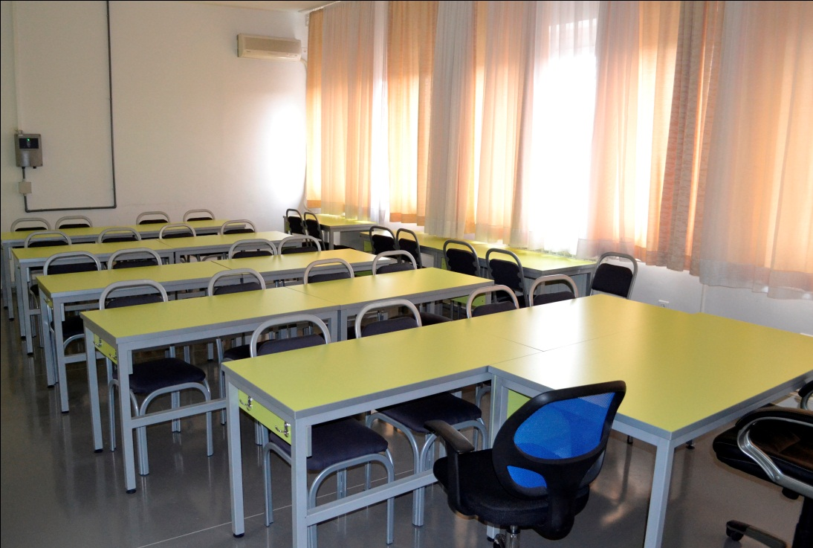
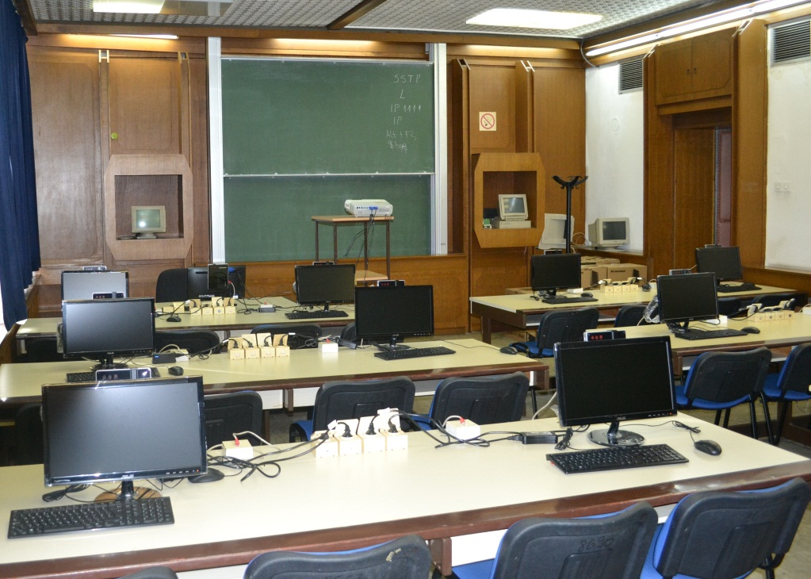
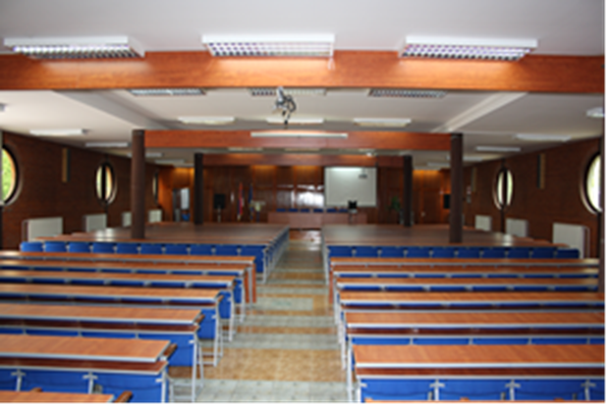
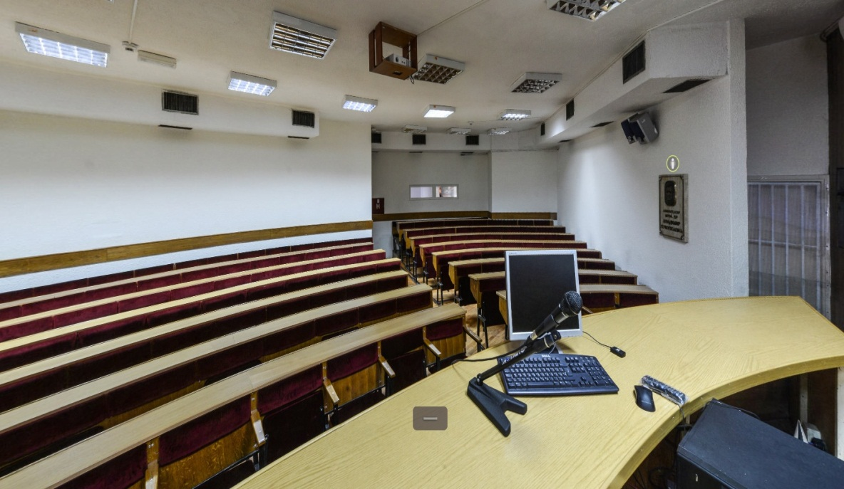
Teachings at the Academy take place in the modernly equipped classrooms, amphitheaters, gym and outdoor sport courts.

Slide 16
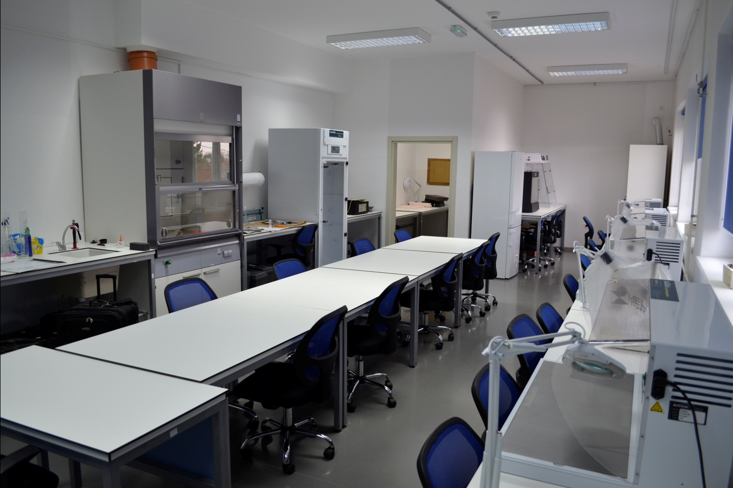
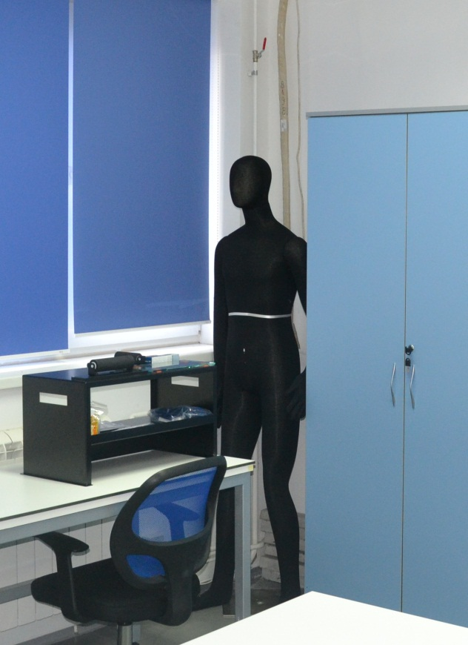
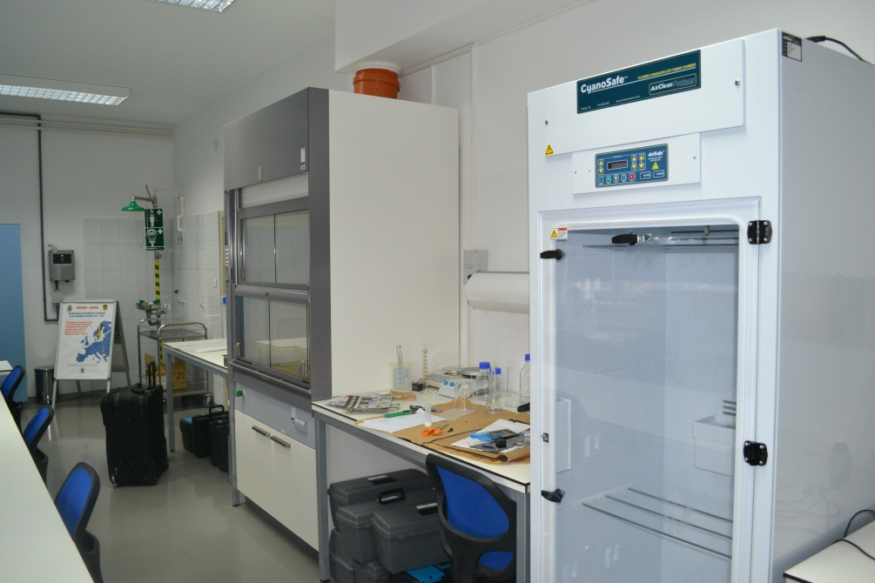
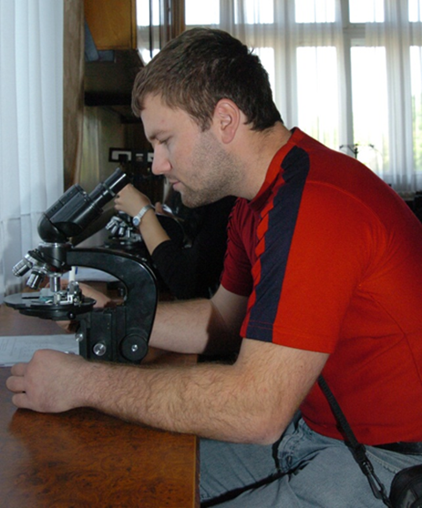
Forensic Laboratory

Slide 17
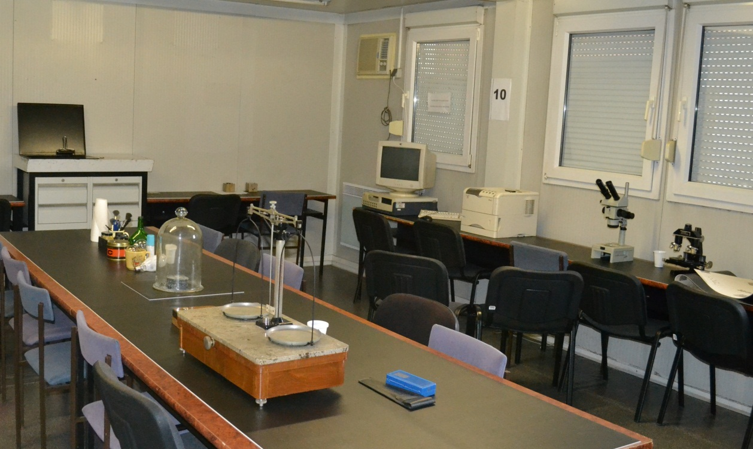
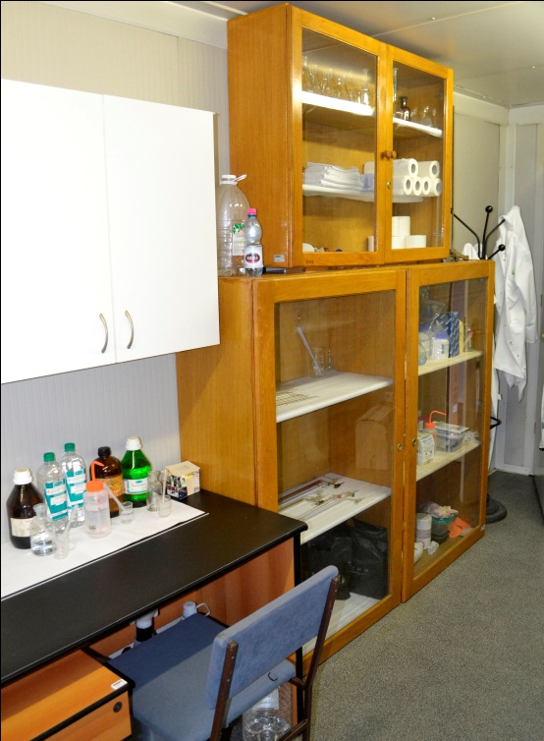
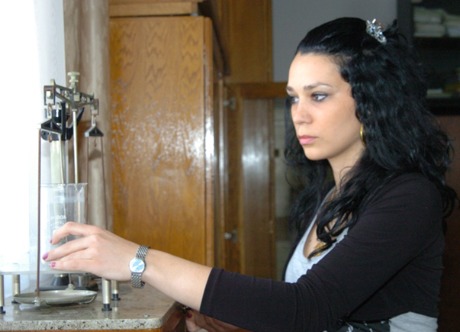
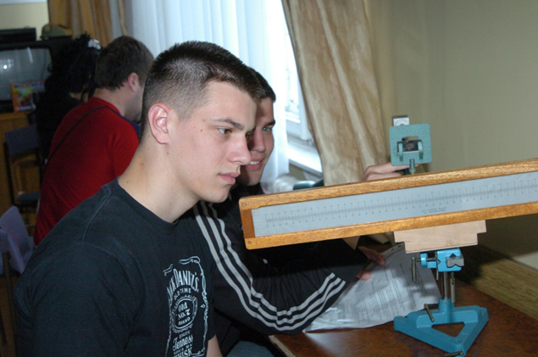
Forensic Laboratory

Slide 18
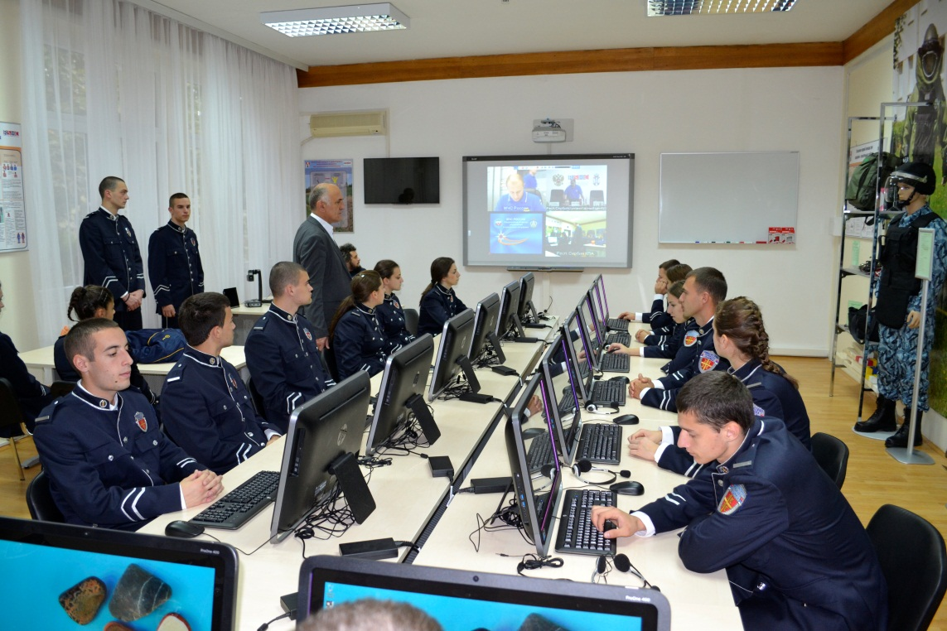
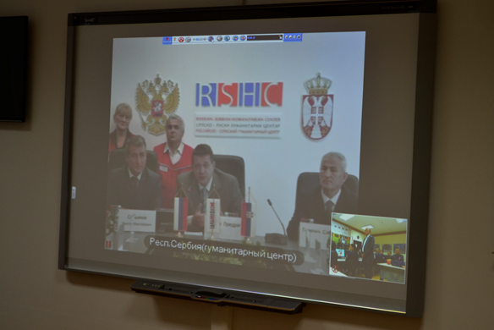
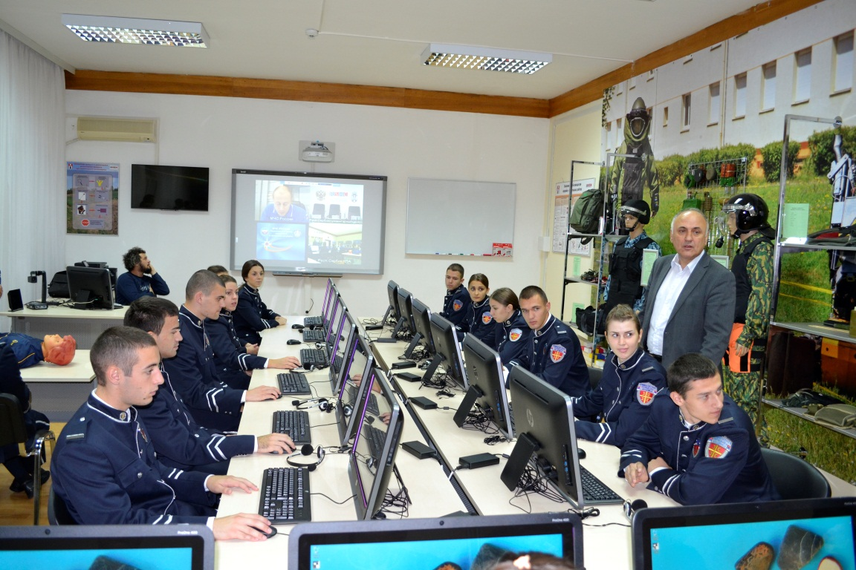
Emergency Situations Classroom

Slide 19
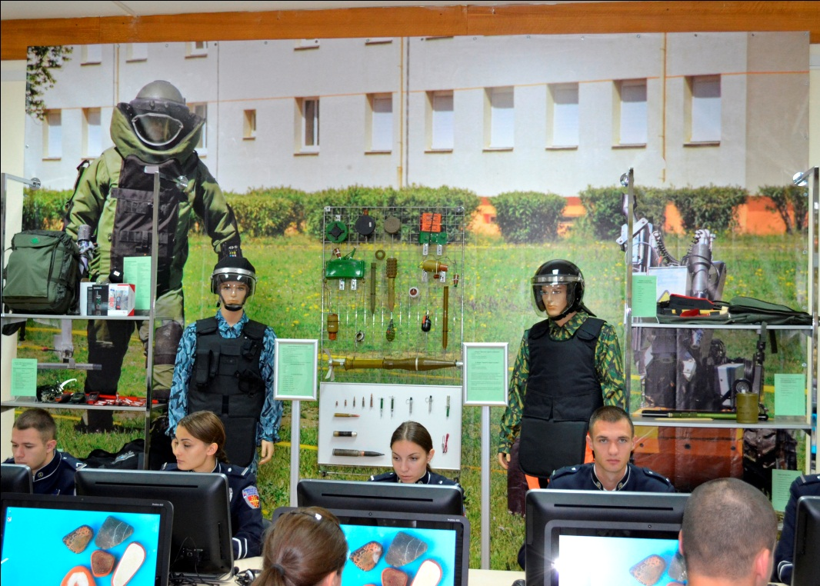

Slide 20
INTERNATIONAL COOPERATION
Development of master curricula for natural disasters risk management in Western Balkan countries
Through international cooperation with related institutions in the country and abroad, the Academy seeks to expand partnership in the fields of education and science. It comprises :
Exchange of teachers and students;
Cooperation in the field of publishing and exchange of teaching and professional literature;
Organization of joint research projects, scientific and professional conferences and seminars;
Staff training, organization of joint lectures, sports activities and other forms of cooperation of mutual interest.

Slide 21
The Academy has signed cooperation agreements with the following institutions:
Faculty of Criminal Justice and Security, University of Maribor, Ljubljana, Slovenia
Police College in Banjaluka, Republic of Srpska, Bosnia and Herzegovina
The Volgograd Academy of the Russian Internal Affairs Ministry, Russian Federation
Faculty of Security, University “St Kliment Ohridski”, Macedonia
State University of Internal Affairs in Lviv, Ukraine
Academy of Police Force in Bratislava, Slovakia
National Police University of China, P. R. China
Swedish National Police Board
DCAF (Geneva Centre for the Democratic Control of Armed Forces)
Police Academy in Szczytno, Poland
University of Banjaluka, Republic of Srpska, Bosnia and Herzegovina
Lithuanian Police School, Lithuania
IRZ - German Foundation for International Legal Cooperation
Academy of the Interior Ministry of the Republic of Belarus, Republic of Belarus
Obuda University – “Banki Donat” Faculty, Hungary
Police College, the State of Qatar
Spanish National Police School in Avila, Spain
People’s Public Security University of China, China
GIZ – German Association for International Cooperation
Saint Petersburg University of MoI of the Russian Federation

Slide 22

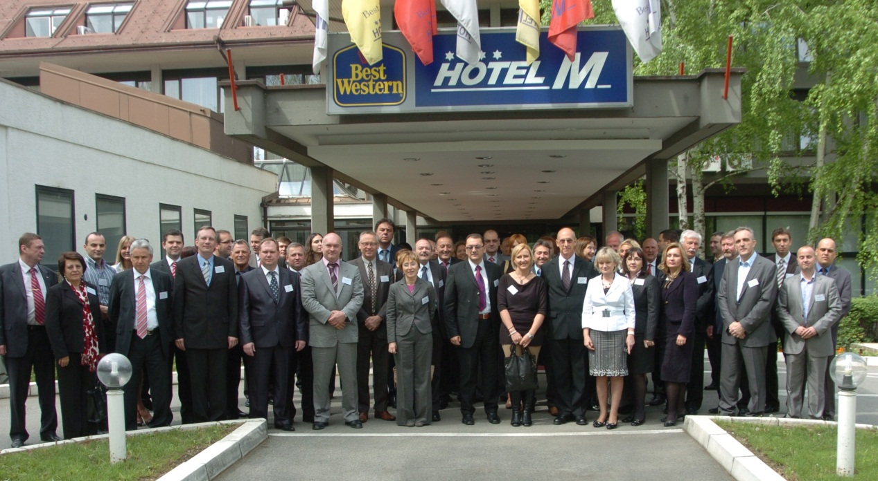
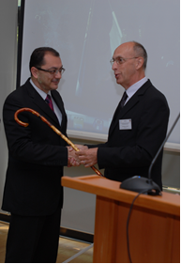
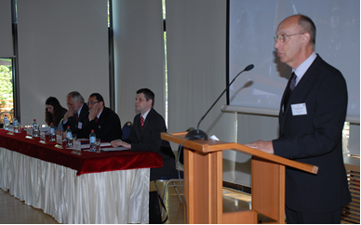
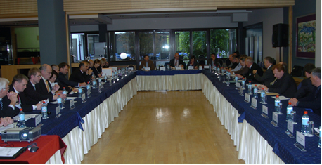
The Academy if a member of the Association of European Police Colleges – AEPC

Slide 23
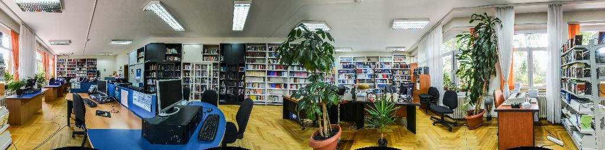
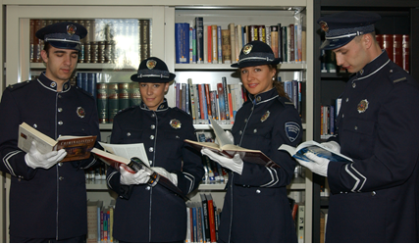
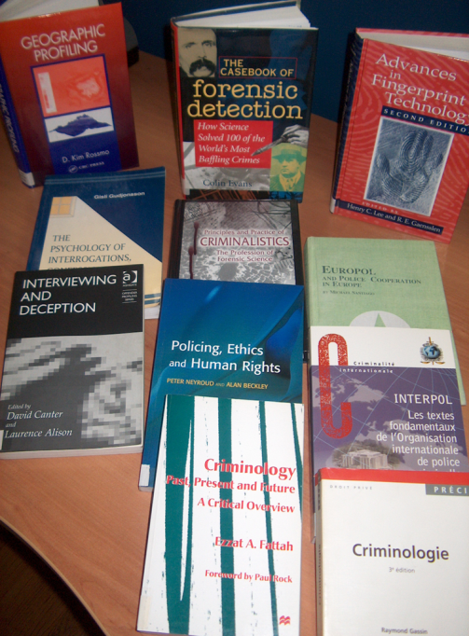

THE ACADEMY’S LIBRARY HOLDS 34 000 BOOKS AND JOURNALS IN THE FIELDS OF CRIMINALISTIC, LEGAL AND OTHER SOCIAL SCIENCES.

Slide 24
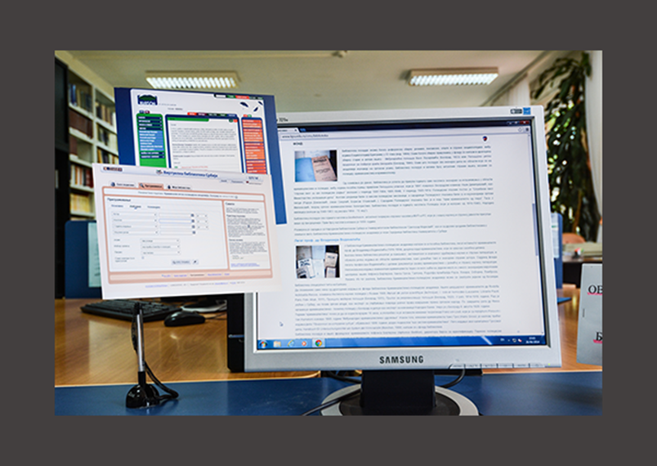
The Academy’s Library is a full member of COBISS.SR within the Serbian Virtual Library project. www.kpa.edu.rs

Slide 25
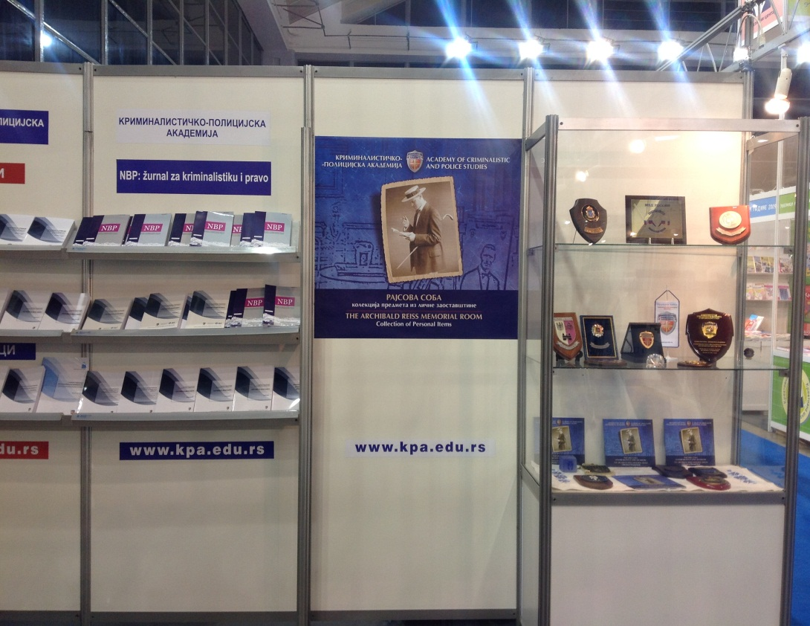

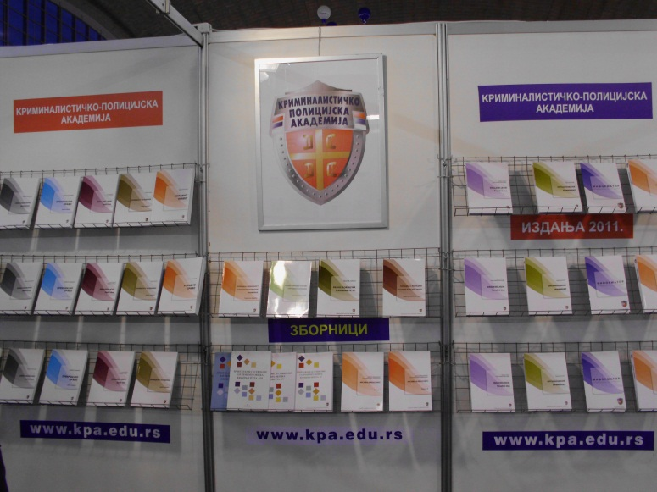
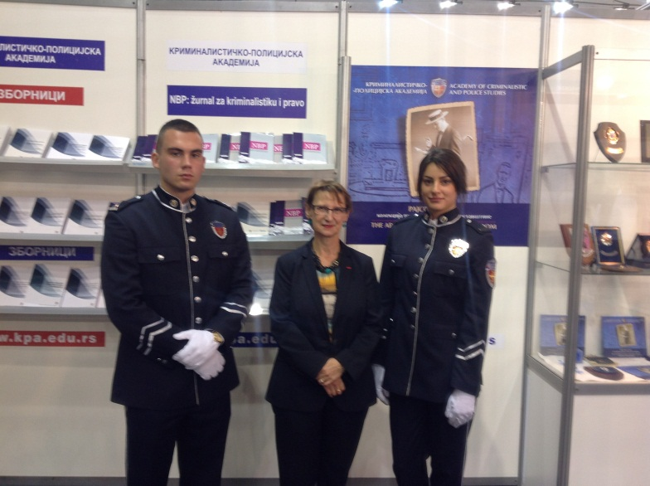
The Academy’s publishing activity is aimed at creation of specialized scientific and professional books in the fields of criminalistic, security and police sciences, as well as legal and social sciences.

Slide 26

Therefore, the Academy:
Development of master curricula for natural disasters risk management in Western Balkan countries
already carries out master’s studies,
is able to accredit a new study program of master’s studies in the field of emergency situations,
has the scientific field "Security in emergency situations" and the departments of security, police science, etc.,
has accredited three study programs of doctoral studies and
is expected to be accredited as a University of Criminalistic and Police Studies in the next few months.

Slide 27

Thank you for your attention!
Development of master curricula for natural disasters risk management in Western Balkan countries

